Slide 1
INVESTMENT ASSIGNMENT SUBMISSION
Name: Paresh Pradhan

Slide 2
Problem Description
The CEO of Spark Funds, an asset management company, wants to understand the global trends in investments so that she can take the investment decisions effectively.
The objective is to identify the best sectors, countries, and a suitable investment type for making investments. The overall strategy is to invest where others are investing, implying that the 'best' sectors and countries are the ones 'where most investors are investing'.
Spark Funds has two minor constraints for investments:
It wants to invest between 5 to 15 million USD per round of investment.
It wants to invest only in English-speaking countries because of the ease of communication with the companies it would invest in.

Slide 3
Methodology
Data Cleaning
Funding Type Analysis
Country Analysis
Sector Analysis – Identify Primary & Main Sectors
Sector Analysis – By Funding & Country

Slide 4
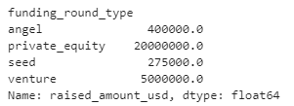
Funding Type Analysis
Merge companies and rounds2 data based on company_permalink_lower == permalink_lower.
Filter data to one of these funding types: 'venture', 'angel', 'seed', 'private_equity’.
Get median value for raised_amount_usd for each of these funding types.
'venture’ is the only funding type whose representative value falls within Spark Fund’s limit of 5M-15M USD.

Slide 5
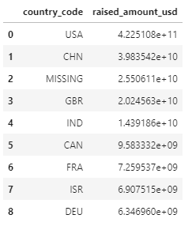

Country Analysis
Filter data to 'venture’ funding type.
Calculate sum of raised_amount_usd grouped by country_code and get the top 9 countries from that list.
Use Wikipedia to filter for only the English-speaking countries in the list and identify the top 3.

Slide 6
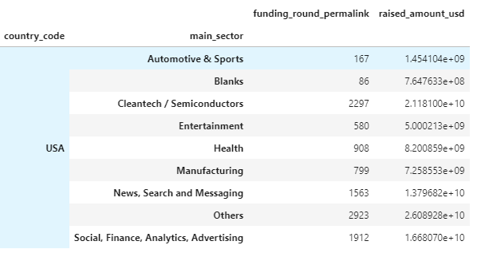
Sector Analysis
Filter data to country_code == ['USA', 'GBR', 'IND’]
Extract primary_sector from category_list.
Use primary_sector and mapping file to get the main_sector.
Filter data to funding range 5M-15M USD.
Split data into 3 dataframes by country.
Calculate the following for each main sector in each of the three countries:
total number of investments (row count)
total amount of investments (sum of raised_amount_usd)
Identify the top 3 sectors for each of the 3 countries by number of investments.

Slide 7
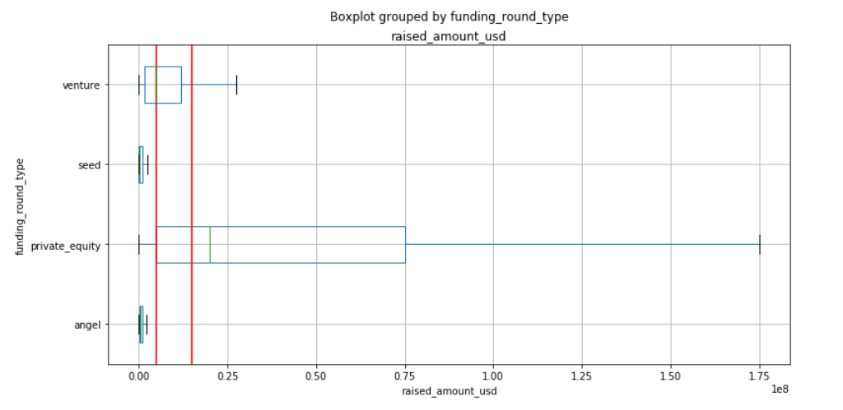
Representative Investment Amount for each Funding Type
The two red lines represent the upper and lower limit for the Investment range for Spark Funds – 5M-15M USD.
For venture funding type both the median and 75 percentile value fall within this range.
On the other hand, for private_equity even the median is beyond this range.
Seed and Angel types are too small for Spark Funds investment.

Slide 8
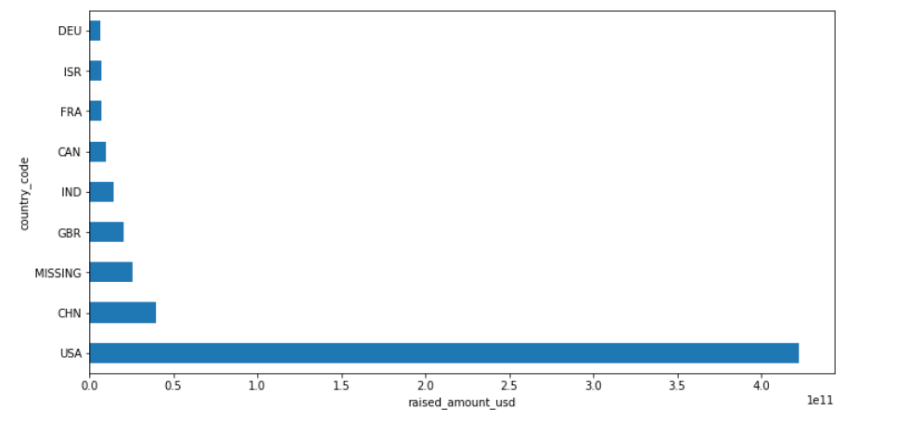
Top 9 countries based on total amount of investments within funding type venture
We ignore the MISSING value.
After filtering for English-speaking countries, the top three are USA, GBR & IND.

Slide 9
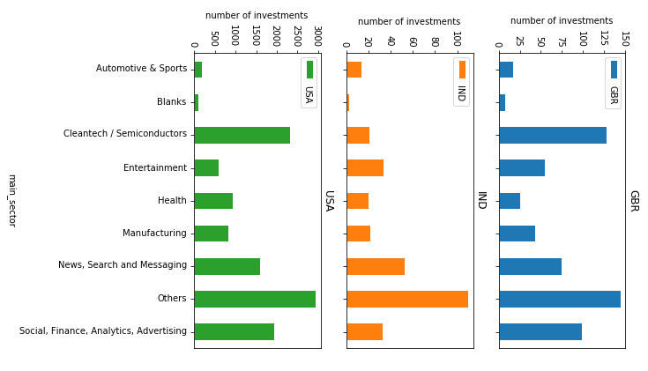
Number of investments in the top 3 sectors of the top 3 countries for venture investment type

Slide 10
Conclusions
Based on our analysis, Spark Funds should invest in the following sectors and countries and the venture funding type:
USA:
Cleantech / Semiconductors
Social, Finance, Analytics, Advertising
News, Search and Messaging
GBR:
Cleantech / Semiconductors
Social, Finance, Analytics, Advertising
News, Search and Messaging
IND:
News, Search and Messaging
Entertainment
Social, Finance, Analytics, Advertising
* We have ignored the Others sector here.

